Slide 1
Technical Arts (TA 101AA)
Engineering Graphics
Prof. Nachiketa Tiwari
Department of Design

Slide 2
Section Views

Slide 3
Salient Features of Sections
Sections are to be used only if some new information is revealed.
Use half section only if full section will not reveal any new information.
Sections should be hatched appropriately.
Hidden lines are not shown in sections.

Slide 4
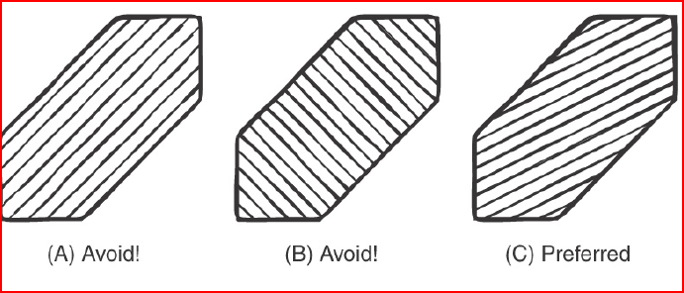
Sectional Views

Slide 5
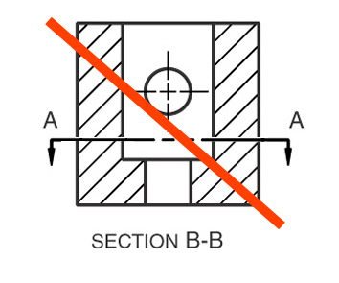
No Cutting Plane on a Section

Slide 6
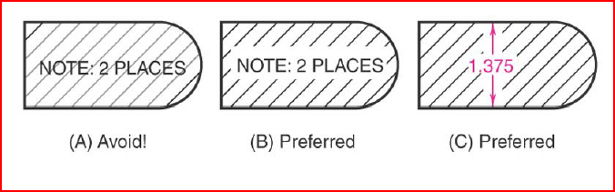
Sectional Views

Slide 7
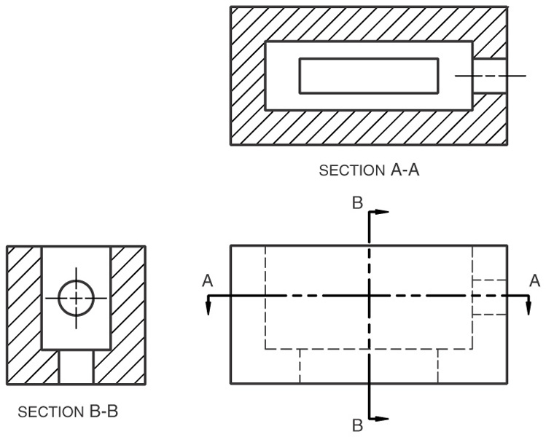
Multiple Sections on a Single Object

Slide 8
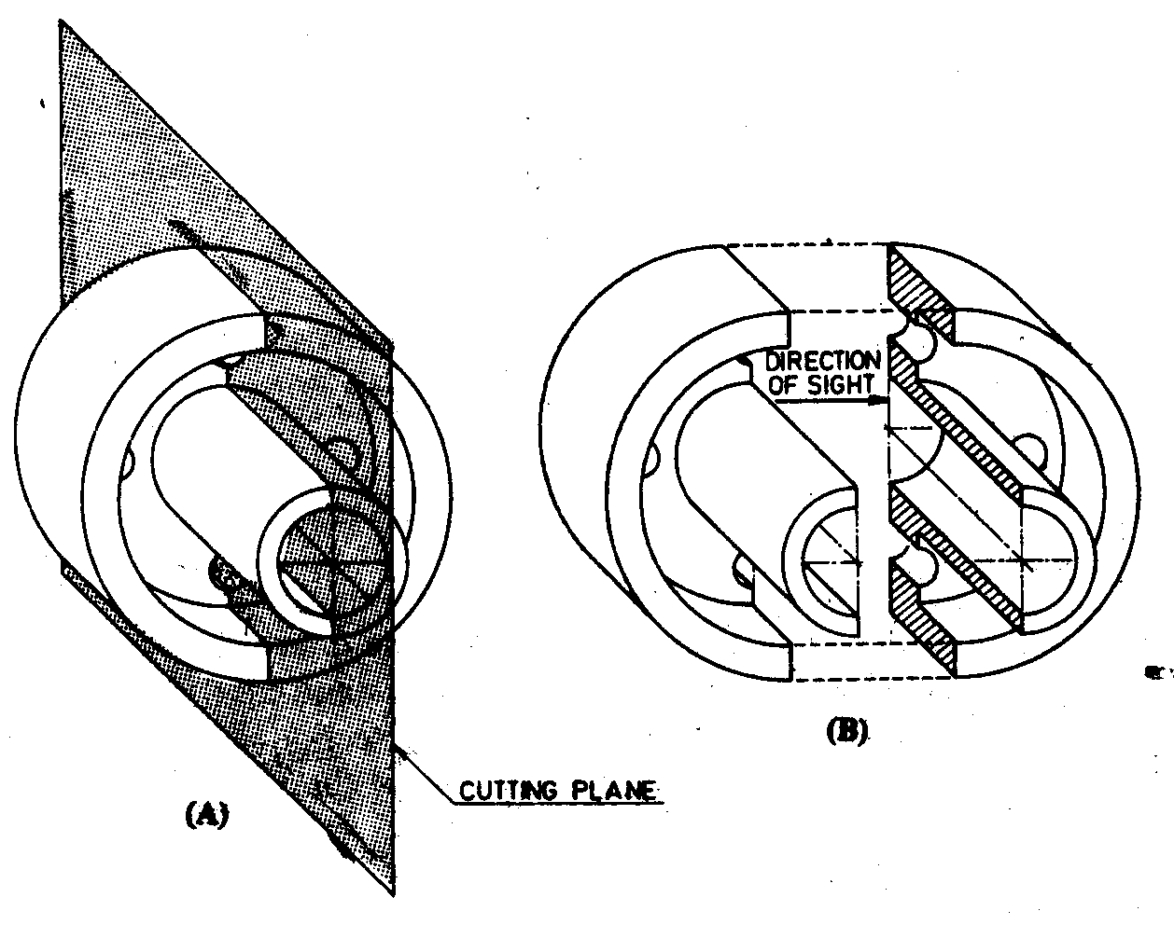
Section Views
Full section
  Straight Offset
  Inclined Offset & inclined
Half section
Revolved section
Removed
Broken-out
Auxiliary
Assembly

Slide 9
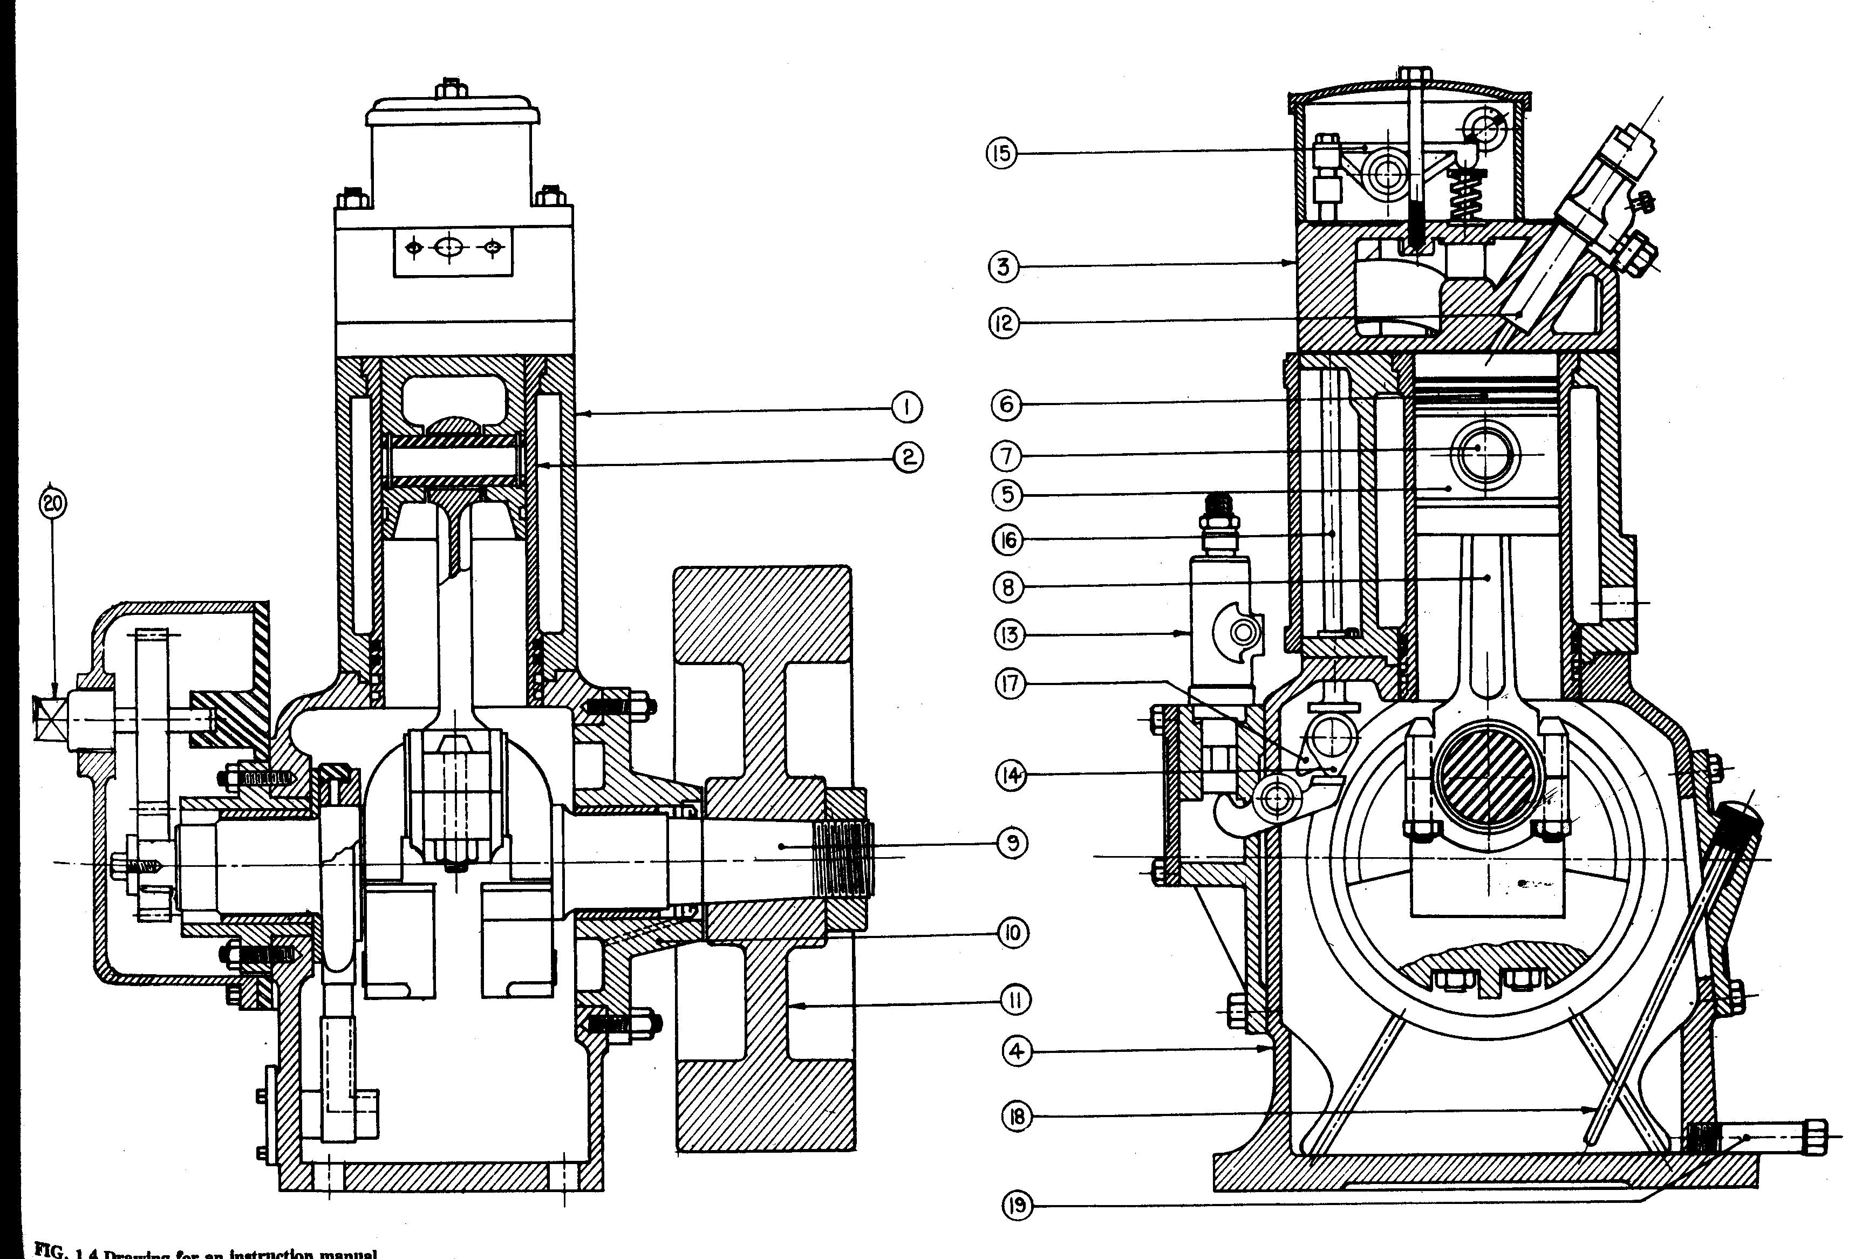
Section View

Slide 10
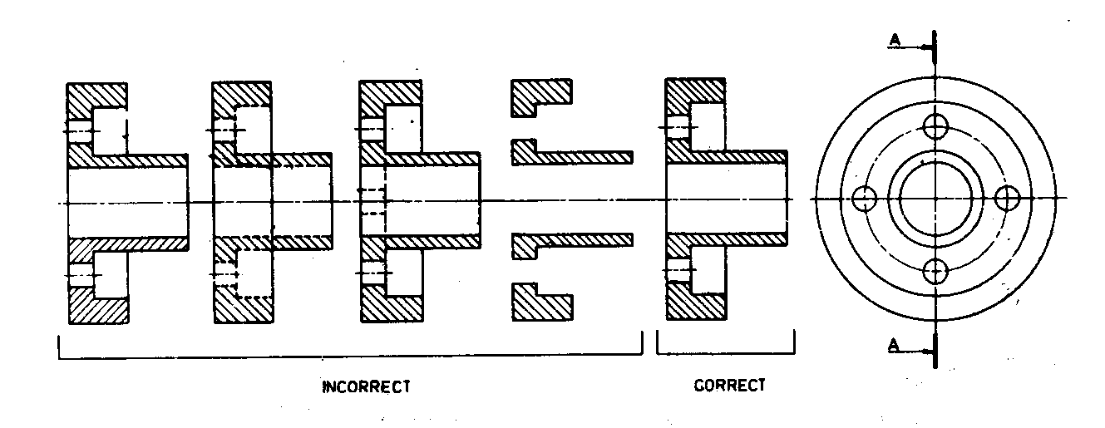
Full Section

Slide 11
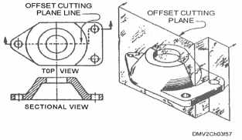
Offset Section View
Shown in 3rd Angle Projection

Slide 12
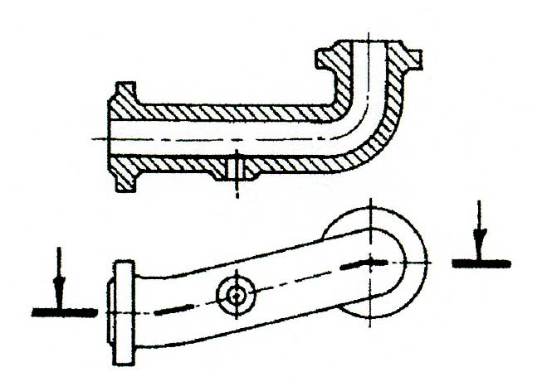
When two end planes are parallel (and offset), the section is drawn in true projection unless otherwise indicated so that connecting planes are foreshortened and the sectional view shows the part in true projected length.
Important Comment

Slide 13
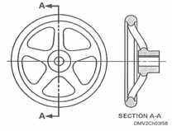
Aligned Section View
Cutting plane bends to pass through specific features of an object, then revolves and aligns to a position across from the original view.
Use aligned sections to give a clearer view and more complex description of objects.

Slide 14
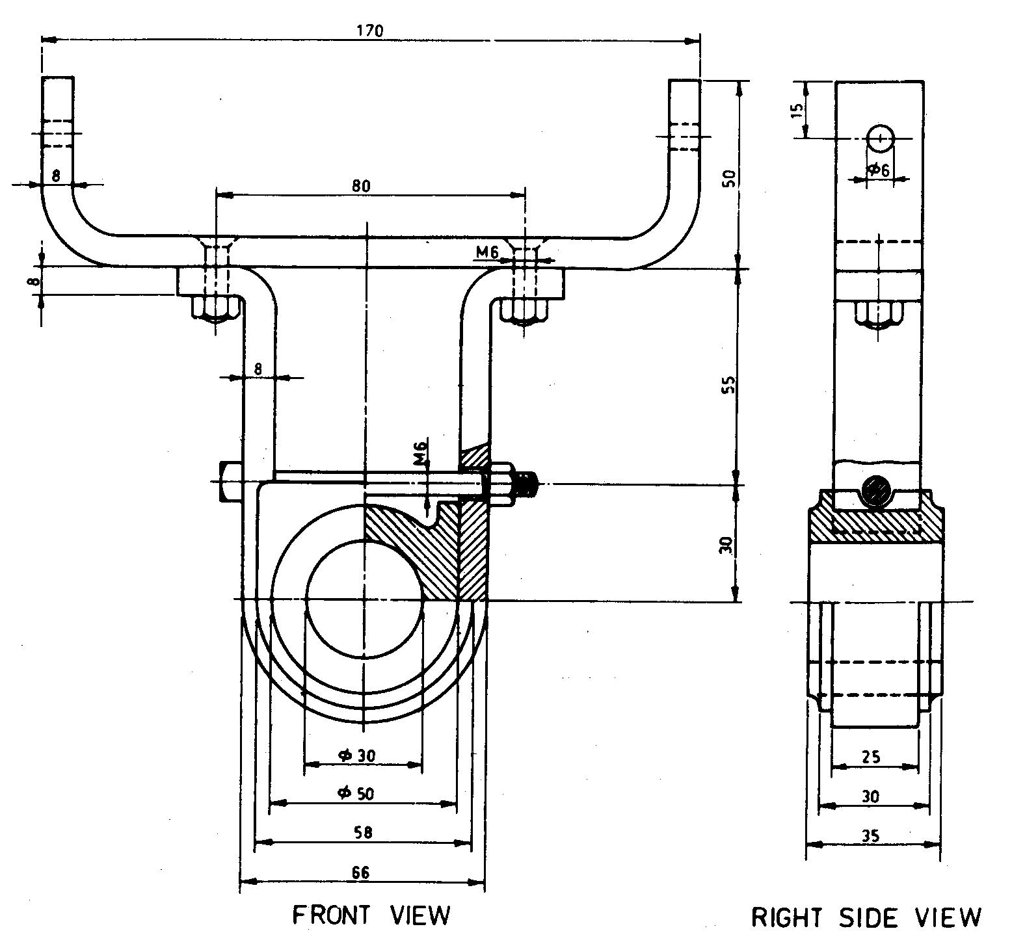
Half Section
Useful for objects symmetric about central axis.
Two cutting planes

Slide 15
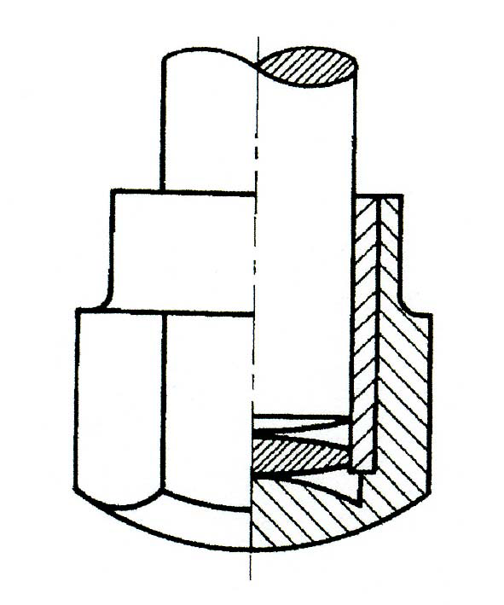
Half Section
No need to display those hidden lines in full portion, which show up explicitly in section view.

Slide 16
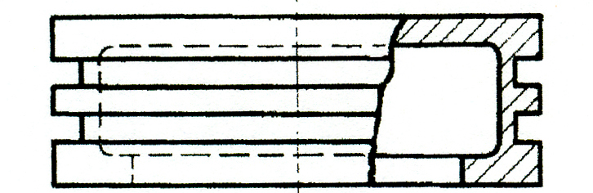
Partial Section View

Slide 17
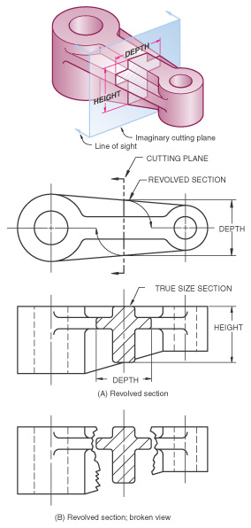
Revolved Section View
Made by revolving the cross section view of a feature 90° about an axis of revolution and superimposing the section view on the orthographic view.
(A) If the revolved section view does not interfere or create confusion on the view, then the revolved section is drawn directly on the view using visible lines.
(B) If the revolved section crosses lines of the view on which it is to be revolved, then the view can be broken for clarity.

Slide 18
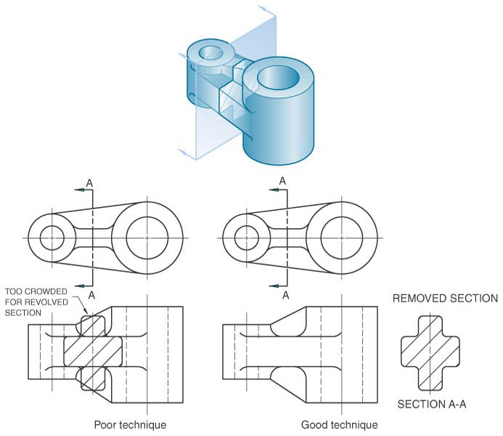
Removed Section View
Similar to revolved section. However, here the cross section is revolved and then drawn adjacent to the orthographic view, not on it. These are used where there is lack of room on the view.

Slide 19
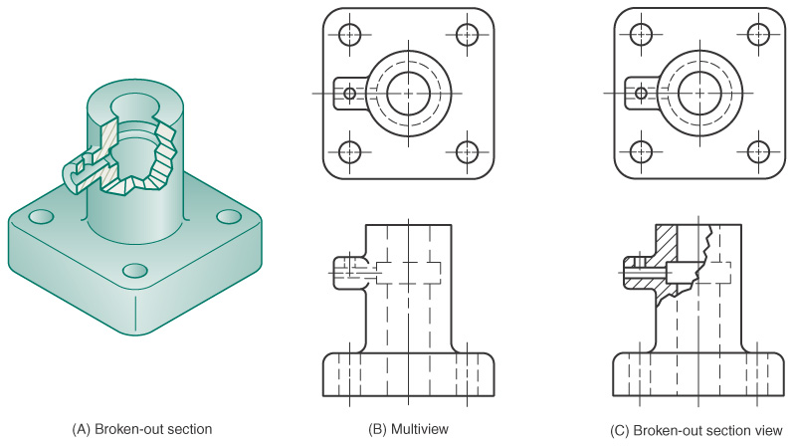
Broken Section View
A broken-out section is used to save time, and here only a portion of the object is sectioned. A break line is drawn freehand to represent the jagged edge of the break.

Slide 20
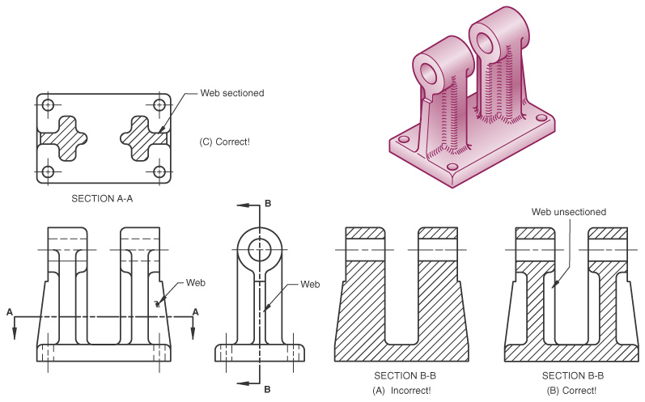
Hatching Thin Wall Sections!!
Not done - If cutting plane passes parallel to the feature.
Done – If cutting plane is normal or cross-wise to feature.

Slide 21
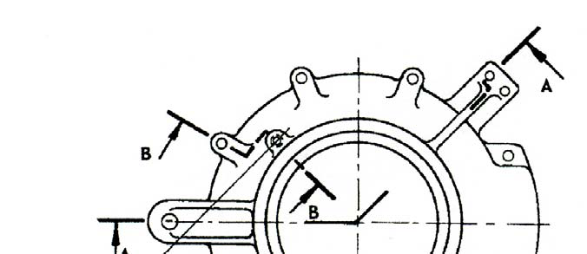
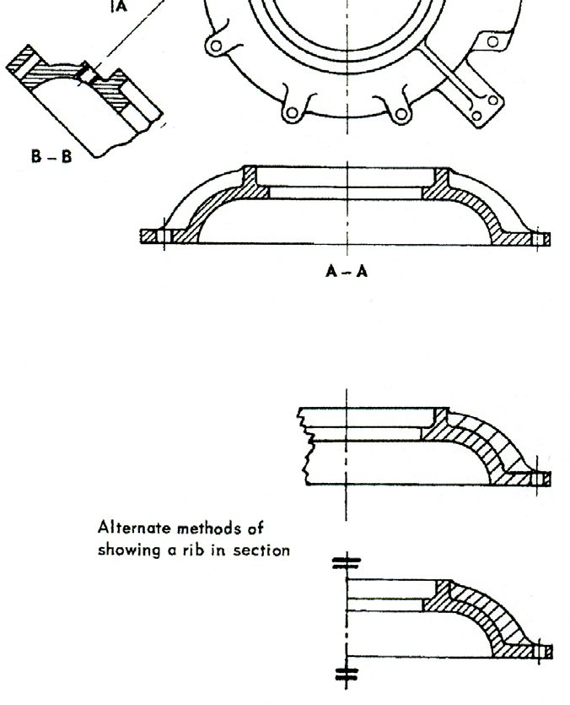
More on Sections
When the end planes are not parallel, the non-parallel plane or planes are revolved into the plane of projection.

Slide 22
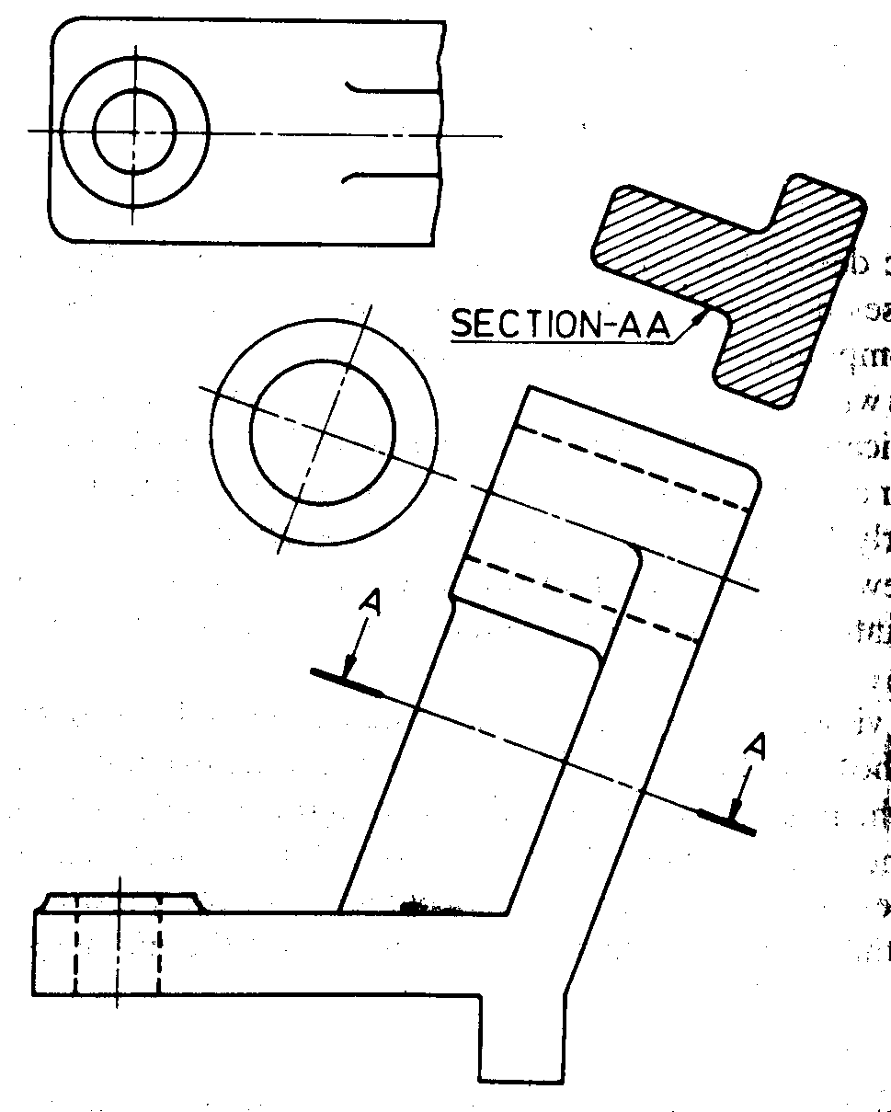
Auxiliary Section

Slide 23
Auxiliary Projection
Auxiliary projection: Projection on any other plane other than the horizontal and vertical plane.
  Primary auxiliary projection: inclined face perpendicular to any one principal plane.
  Secondary auxiliary projection: inclined face is not perpendicular to any principal plane.
Purpose: To depict details in specific directions.

Slide 24
Types of Auxiliary Projection
Front auxiliary projection
Side auxiliary projection
Top auxiliary projection.

Slide 25
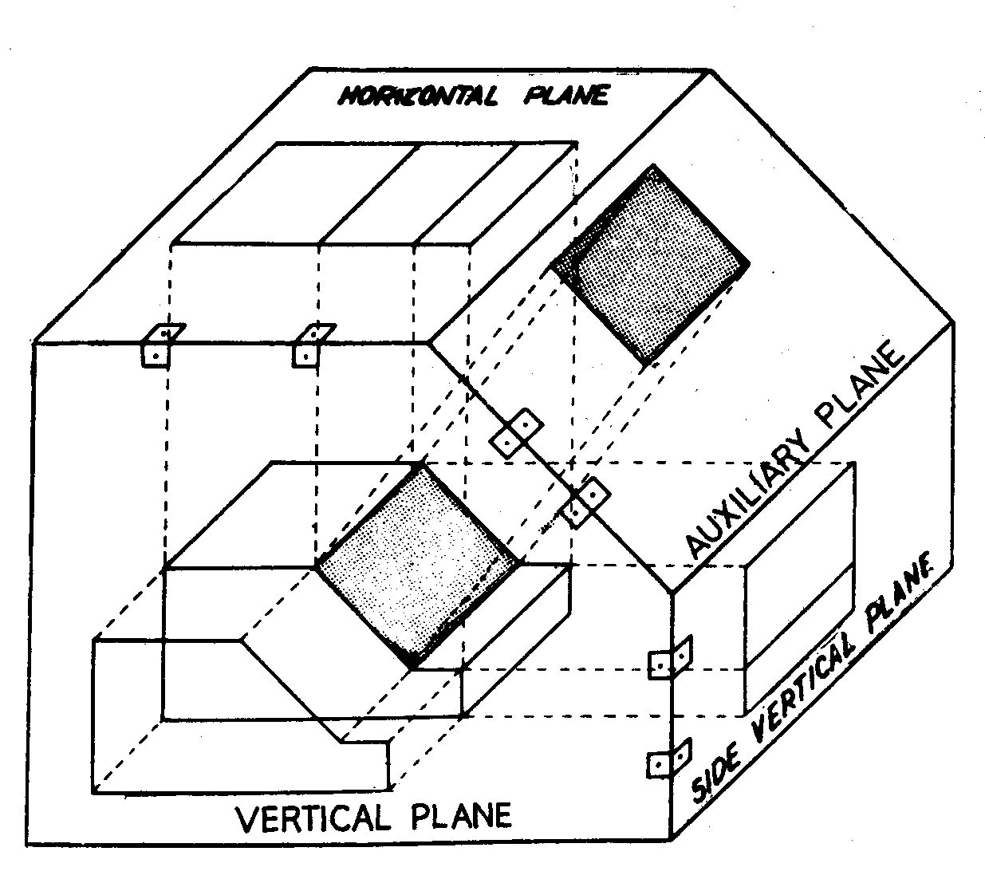
Auxiliary Projection
Three views are not enough : auxiliary views are required.

Slide 26
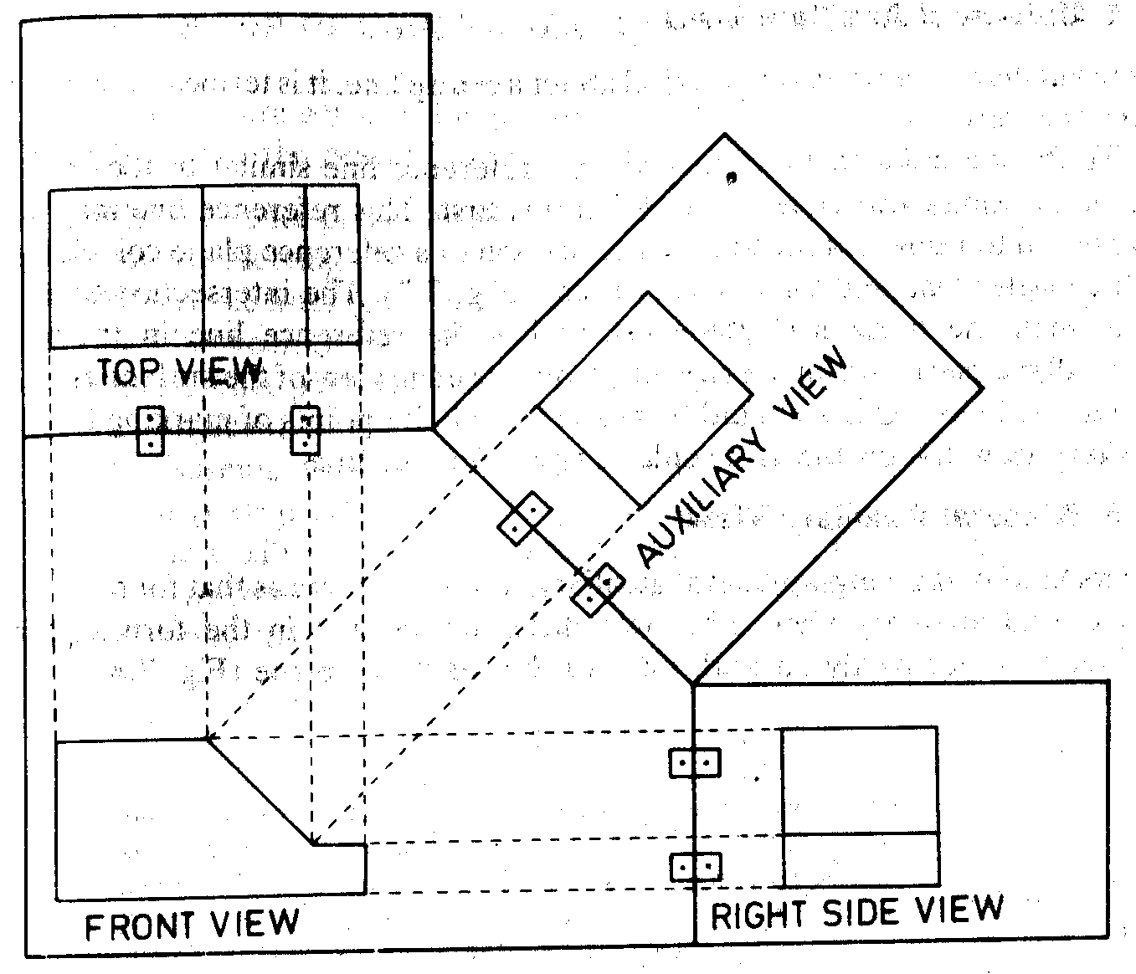
Front Auxiliary View

Slide 27
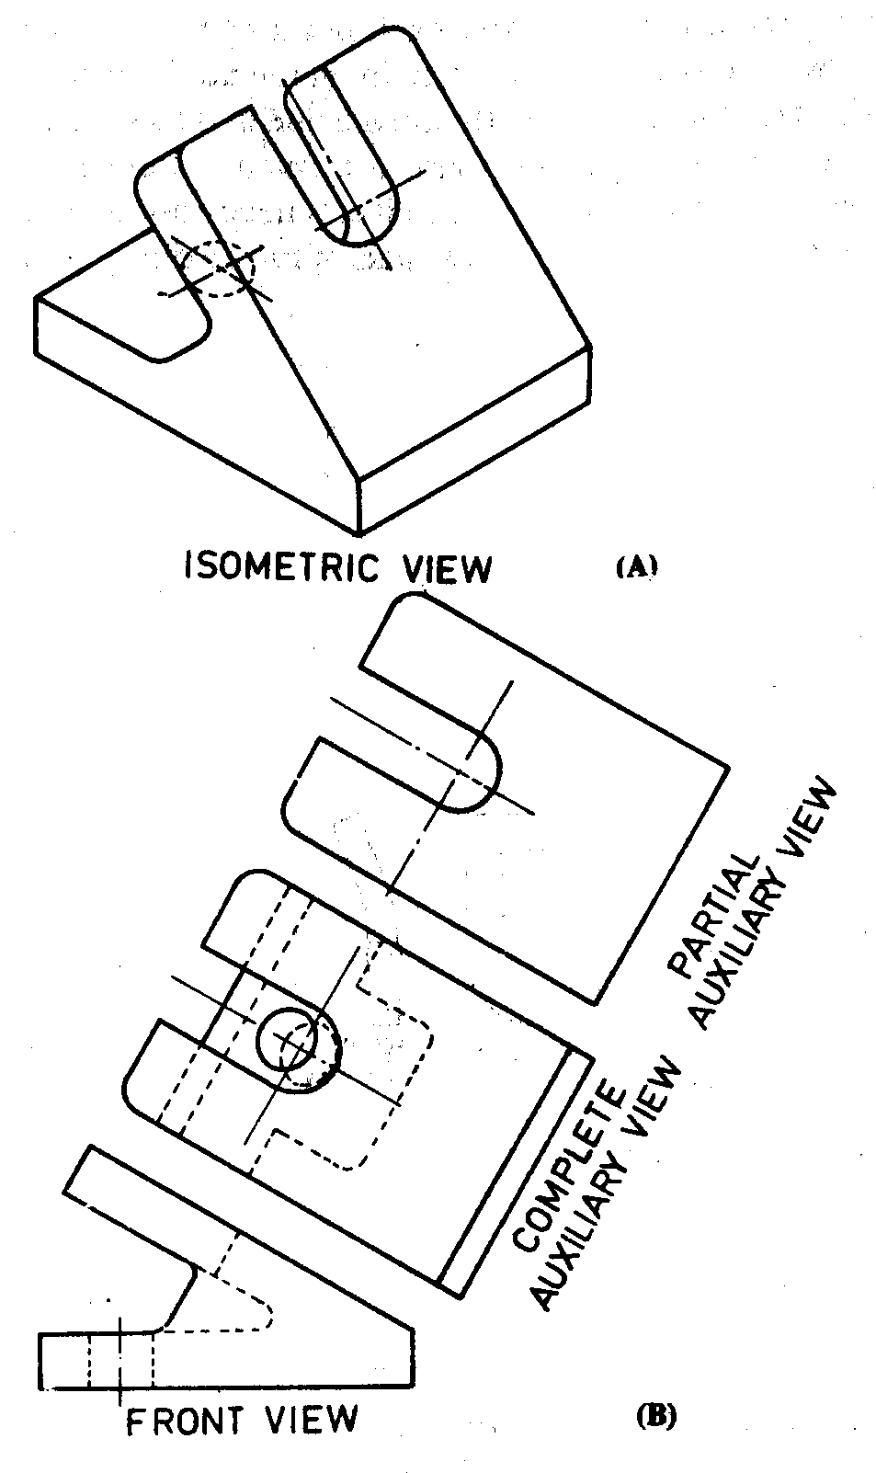

Slide 28
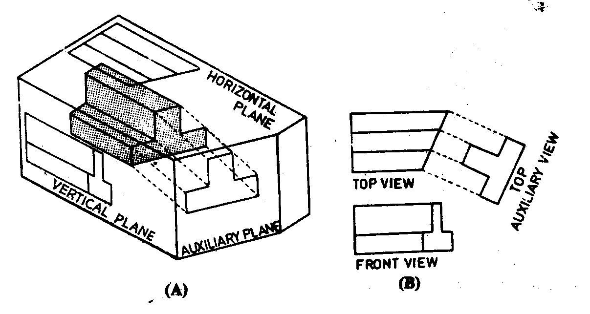
Top Auxiliary View

Slide 29
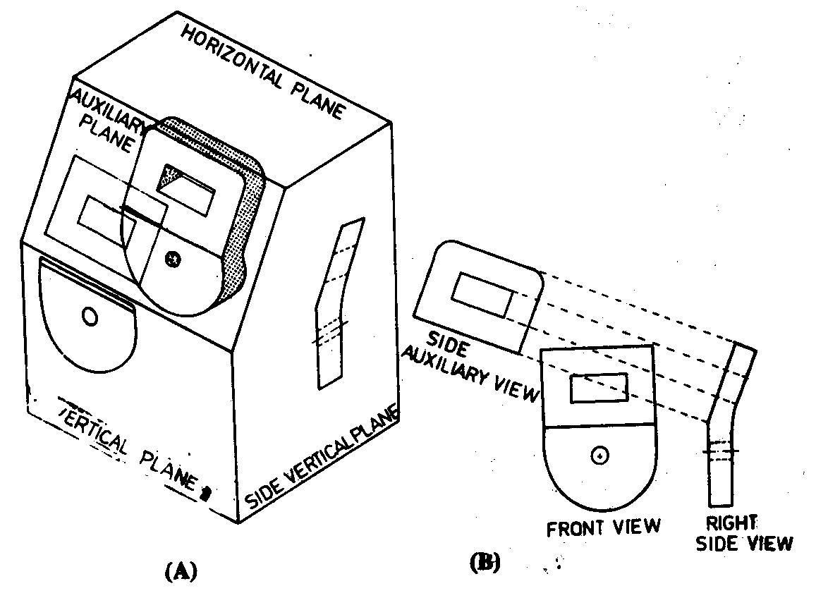
Side Auxiliary View

Slide 30
Rules
Reference plane should be positioned at the most convenient place for the transfer of distances.
Reference lines are at right angles to the projection lines.
Measurements to be made at right angles to the reference lines.

Slide 31
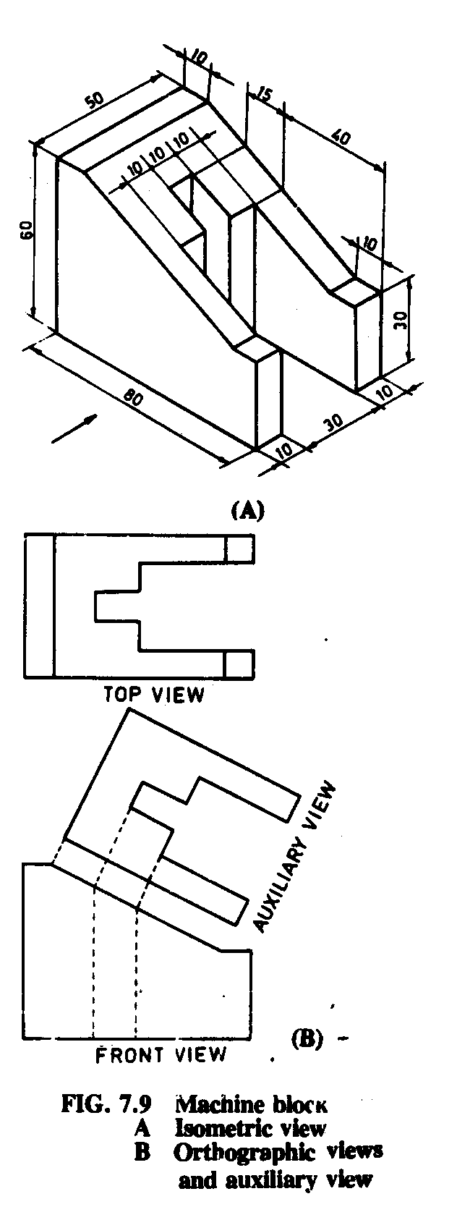

Slide 32
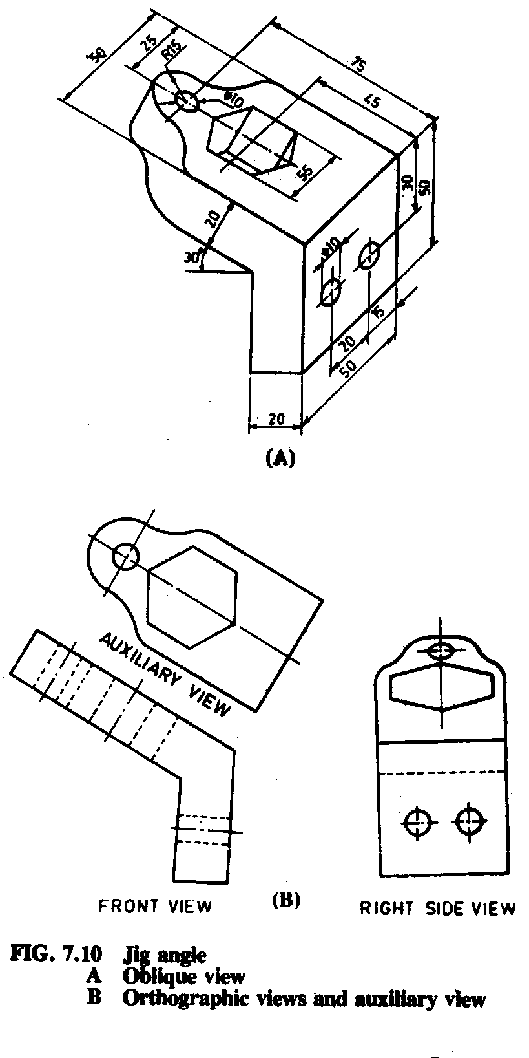

Slide 33
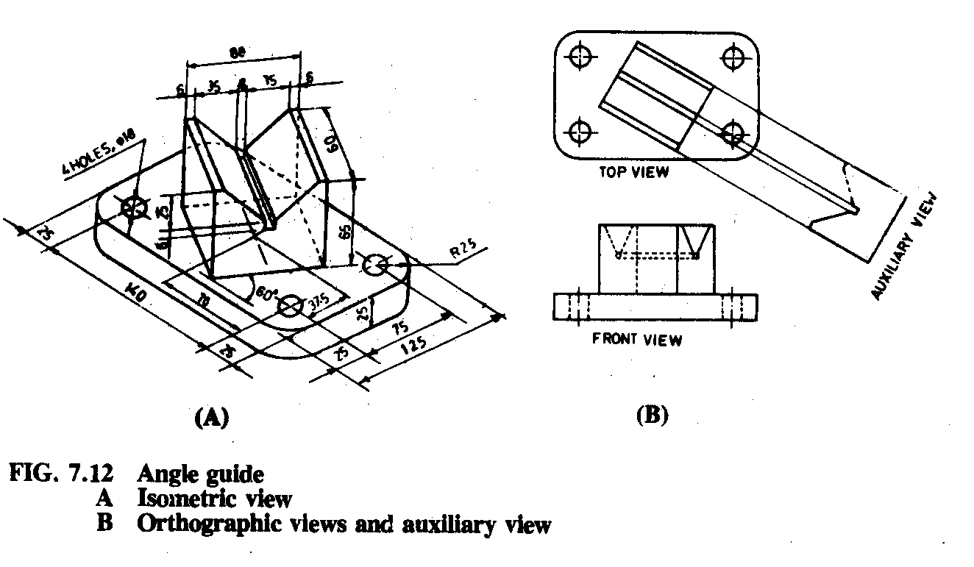

Slide 34
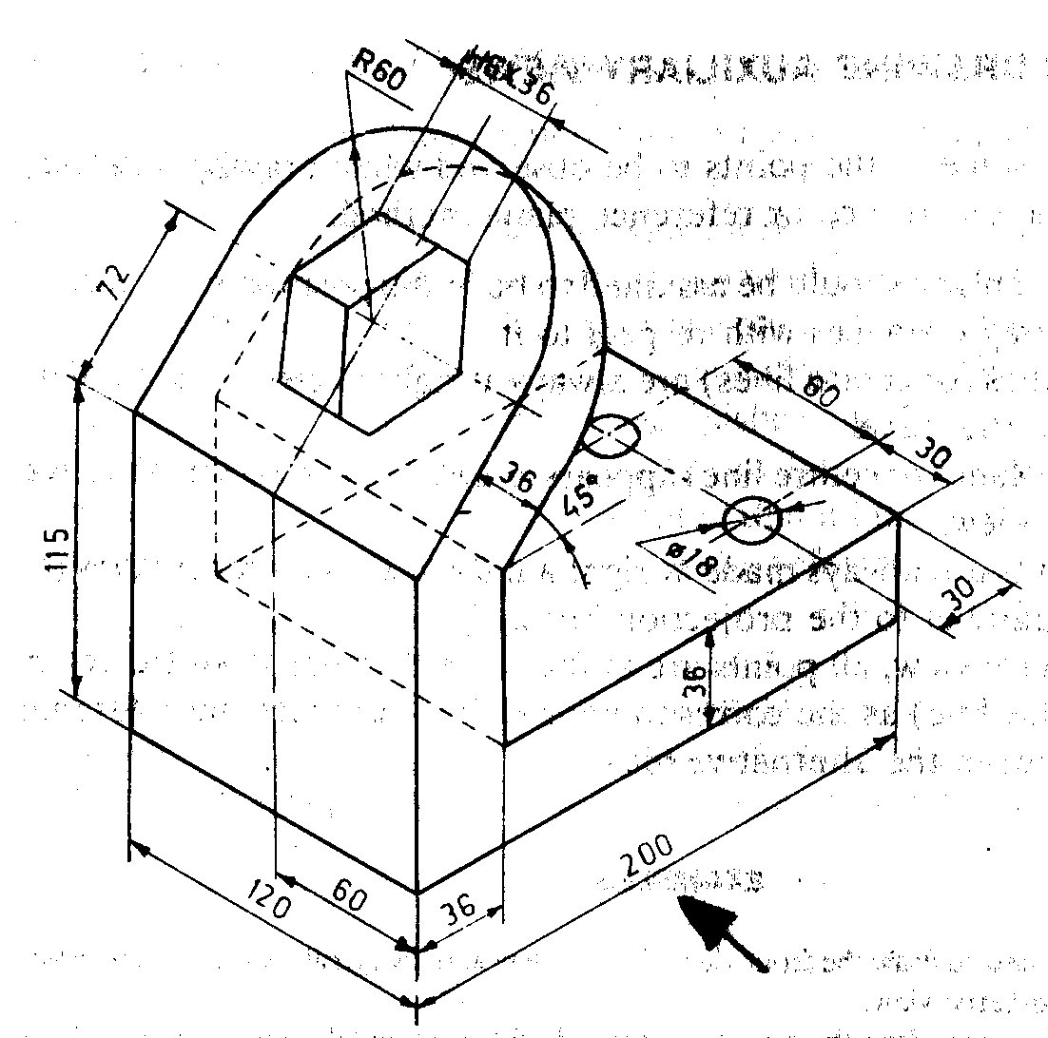

Slide 35
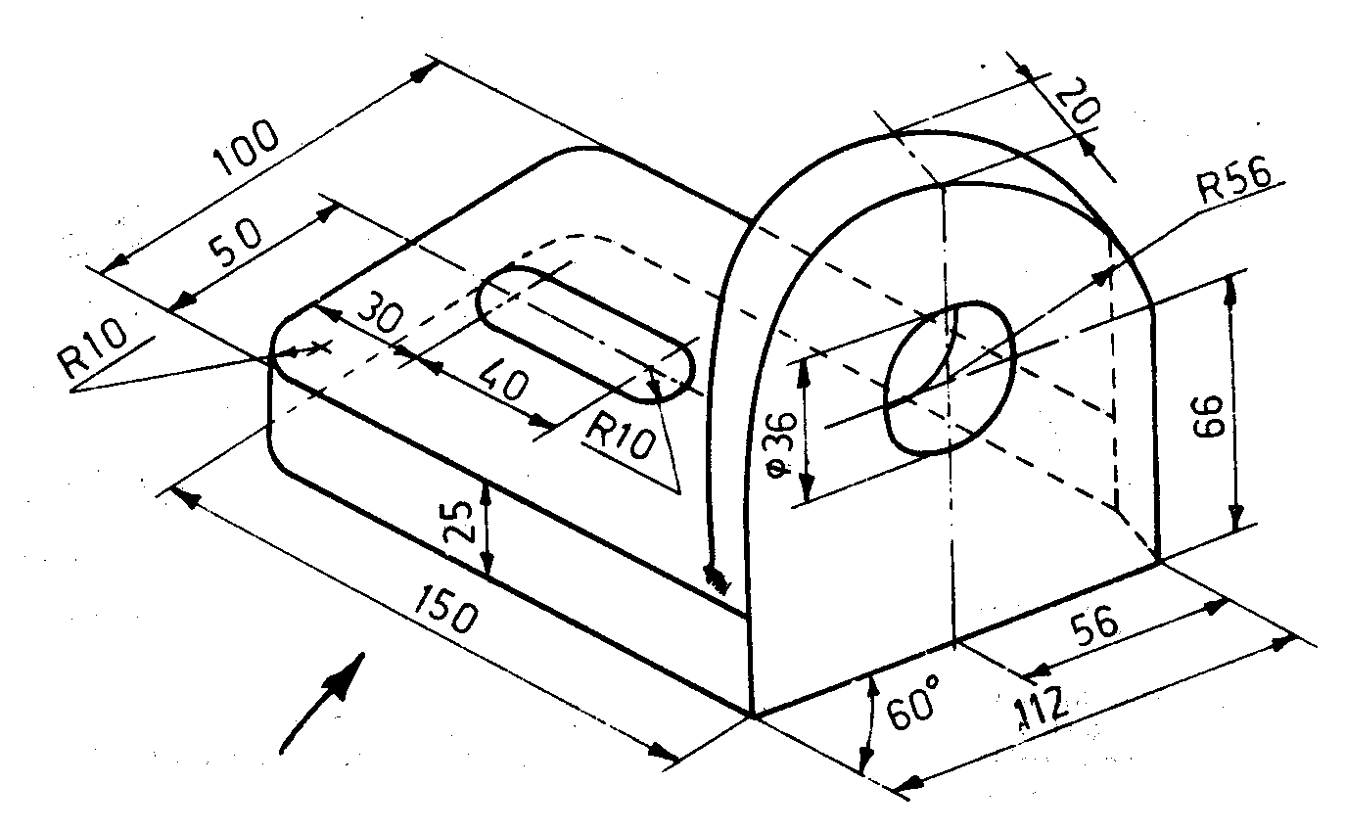

Slide 36
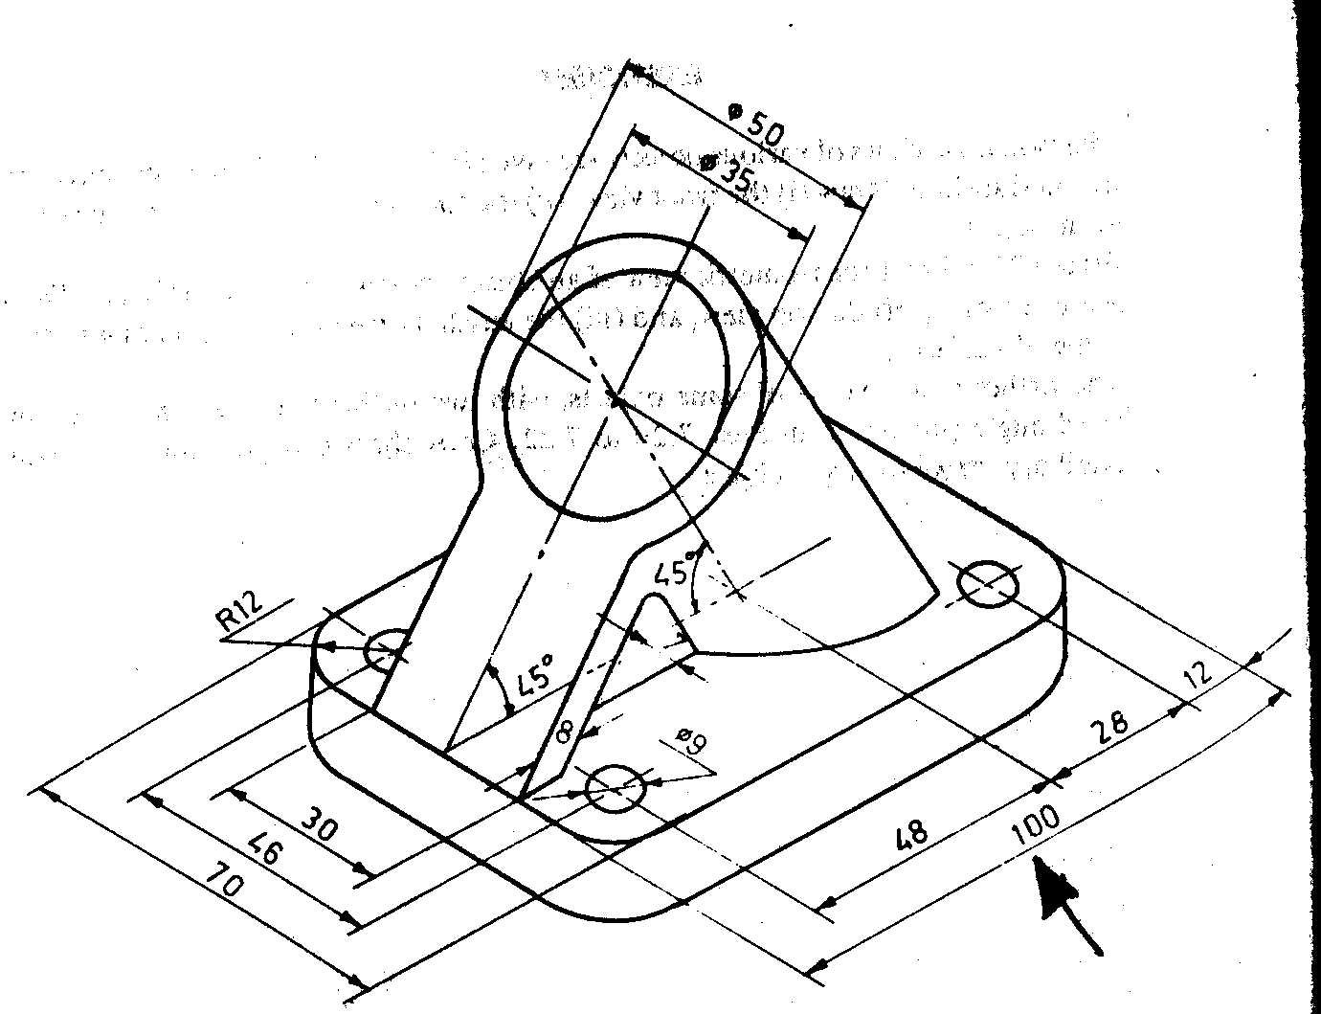

Slide 37
Missing Lines & Views

Slide 38
Missing Lines and Views
Objective: To complete a particular orthographic view for missing line(s) or draw a complete orthographic view
It is always a good idea to draw the pictorial sketch of the ‘possible’ object.
A pictorial image of the complex object can be formed by putting together elemental parts that are easy to visualize
Information from one view is used to complete certain features in another view.

Slide 39
Example: Some Lines Missing

Slide 40
Example: A Missing View

Slide 41
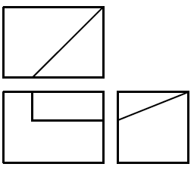
Are There Any Missing Lines?
Try to visualize the possible object.
The ‘possible object’ must match the information/views given.
Remember that some views may be incomplete.

Slide 42
Important Note
For solving most problems, probably the best way to start is to sketch a cuboid of dimensions equal to the outer dimension of the object provided in the given views
The orthographic views given are the projections of the object on three principal faces
Then, attempt to locate key points and edges on the three principal faces of the cuboid
Synthesize the views sketched on the faces of the cuboid to sketch the object
Remember
A line in an orthographic view does not necessarily lie on one of the faces of cuboid; it may be a projection of an edge on the face of the cuboid

Slide 43
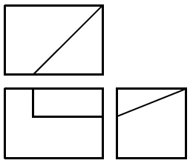
Example 1: Steps
Front view points.
Join those.
RSV points, join those.
Top view points
Join those.
Look-out for inconsistencies
Missing line?

Slide 44
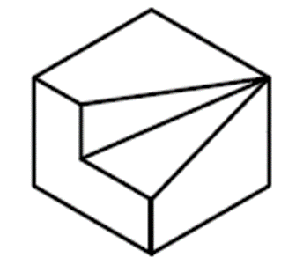
Example1: A DIfferent Approach
6
7
7, 8
2
3
6, 5
B_{T}
5
8
1
4
A_{T}
2, 1
3, 4
3, 2
2, 6
3, 7
B_{F}
A_{R}
B_{R}
7, 6
A_{F}
1, 5
4, 8
4, 1
8, 5

Slide 45
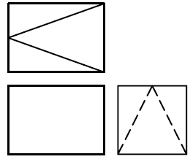
Example 2

Slide 46
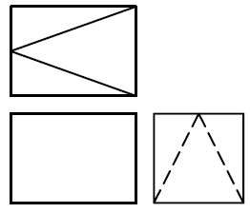
Example 2: Solution
Now, on RSV, there are two hidden lines given. Where are these?
Probably on the back face.
So, where is the missing line?

Slide 47
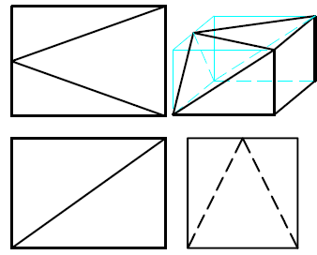
Example 2: Alternate Approach
6
7
7, 8
2
3
6, 5
5
8
A_{T}
1
4
2, 1
3, 4
3, 2
A_{R}
7, 6
2, 6
3, 7
A_{F}
1, 5
4, 8
4, 1
8, 5
It is not as obvious as the previous example
Hence pick appropriate methods for each problem

Slide 48
Important Note
May not have a unique solution to a problem of missing lines and/or views.
Different combinations of certain features in an object may match the information provided.
In such situations, we opt for a solution which requires minimum number of missing lines.

Slide 49
Example 3
Top
View
Front
View
Missing Lines?
RHS
View

Slide 50
Example 4
Missing Lines?

Slide 51
Example 5
Missing Lines?

Slide 52
Example 6

Slide 53
Example 7: Missing View
?

Slide 54
Example 8: Missing View
?

Slide 55
Thank You

